Slide 1
SEL Blueframe Python SDK
Caleb Hansen, Genevieve Kochel, Darron Li, Lucas Phillips
CptS 421

Slide 2
INTRODUCTION
Blueframe is a hardened OS suited for real-time monitoring at edge locations
Common use cases are power substations, real time automation controllers, etc.
Based on stripped-down Linux kernel, everything is containerized
Built for security and reliability, not ease of use: our project aims to address this
To do this, we’ll abstract away low-level Blueframe system API calls written in Go and C via a Python library
During this sprint, our focus was on identifying and securing the access required to work within the Blueframe ecosystem
This included determining dependencies such as the Field SDK, internal repositories, and supporting documentation
In parallel, we developed proof-of-concept features to validate key architectural decisions

Slide 3
SPRINT 2 OBJECTIVES
Determine which secure features and resources are required for development
This involved researching access requirements for the Go SignalHub repository, Blueframe Field SDK, and internal module documentation, all of which are necessary to build and integrate our Python abstraction layer with Blueframe
Determine and address blockers related to accessing required systems and resources
This involved identifying pain points in the access process, following up with stakeholders, and researching pathways to obtain the Go repositories, Blueframe Field SDK, and internal documentation necessary for development
Evaluate feasibility of Go backend integrated with Python frontend
This involved designing and implementing a proof of concept COMTRADE reader and writer in Go, validating that we can wrap Go functionality with a Python interface as intended

Slide 4
FEATURE IMPLEMENTATION
COMTRADE reader module - Lucas
Parses CFG and DAT files written in the COMTRADE format
Reads the files into Python objects and structs for improved usability vs raw input
COMTRADE writer module - Genevieve
Converts Python objects of support formats into COMTRADE signals
Handles timestamps, station monitoring, and signal channeling
COMTRADE system testing harness - Darron
Validates our custom Go implementation using open-source alternatives to build collective validation
Field SDK Setup - Caleb
Set up public-facing Blueframe container using Kubernetes, Tilt, and Docker
Worked with SEL stakeholders to produce and export an externally secure Blueframe SDK … still in progress.

Slide 5
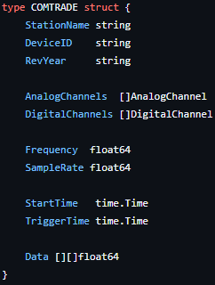
Feature 1: COMTRADE Reading Module - Lucas
Feature Overview Developed a Go-based COMTRADE reader that parses .CFG and .DAT files into digital and analog components
Before No reliable COMTRADE parsing solution within scope Existing tools were proprietary or inconsistent No proof of concept for calling Go from Python
After Functional COMTRADE reader implemented in Go Parses industry-standard files into structured datasets
Testing & Validation Tested across multiple COMTRADE formats Validated data integrity through test cases and manual checks
Relevance to Project Objectives Supports Python SDK development through validated Go integration Provides reliable, programmatic access to industry-standard data

Slide 6
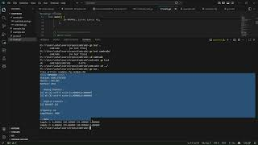
Feature 1 COMTRADE Reading Module Demo

Slide 7
Feature 2: COMTRADE Writing Module - Genevieve
Feature Overview Developed a Go-based COMTRADE writer that converts Python objects into COMTRADE-formatted signals
Before No capability to generate COMTRADE files from internal data structures Limited ability to simulate or test workflows using COMTRADE data
After Functional COMTRADE writer implemented in Go Converts structured data into valid COMTRADE .CFG and .DAT files
Testing & Validation Validated output format against COMTRADE standards Tested with generated data to ensure correct timestamps and channel mapping
Relevance to Project Objectives Supports end-to-end COMTRADE workflow alongside reader module Enables testing, simulation, and future integration with Python SDK

Slide 8
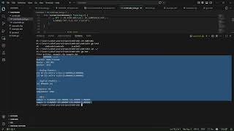
Feature 2 COMTRADE Writing Module Demo

Slide 9
Feature 3: COMTRADE Validation and Testing Module - Darron
Feature Overview Developed a COMTRADE validation and testing module to verify correctness of the Go-based reader and writer
Before No structured way to validate COMTRADE parsing or generation No benchmarking against existing implementations
After Testing harness implemented to validate reader and writer outputs Leverages open-source tools for cross-validation and consistency checks
Testing & Validation Compared outputs against open-source COMTRADE implementations Validated correctness across multiple file types and scenarios
Relevance to Project Objectives Ensures reliability and correctness of COMTRADE tooling Builds confidence in Go-based implementation for future SDK integration

Slide 10
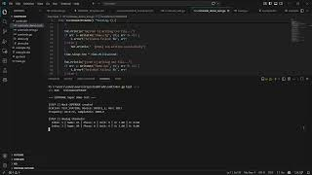
Feature 3: COMTRADE Validation and Testing Module Demo

Slide 11
Feature 4: Field SDK Setup - Caleb
Feature Overview Set up a public-facing Blueframe container using Kubernetes, Tilt, and Docker, and began work on exporting a secure, externally accessible Field SDK
Before No ability to interact with the Blueframe SDK or deploy code to Blueframe devices No development environment available for non-SEL contributors Blocked from building or testing any Blueframe-integrated features
After Partial setup of a containerized Blueframe development environment Progress toward a secure, externally accessible SDK for non-SEL users Learnings around the setup, architecture, and infrastructure for Blueframe, putting us in a strong position to begin working once access is established
Testing & Validation Planned use of Vanguard (SEL internal Blueframe testing tool) for validation once access is granted
Relevance to Project Objectives Critical enabler for all future Blueframe development and integration work Improved understanding of Blueframe architecture and strengthened internal communication channels despite access limitations

Slide 12
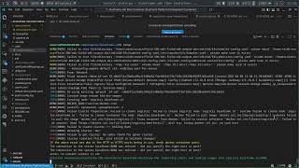
Feature 4: Field SDK Setup Blockers Demo

Slide 13
Figma Prototype and Client Feedback
Our project is an SDK API, and is not intended for end-users other than developers.
As such, a Figma prototype was not applicable - we will not be constructing a UI nor does this project involve Figma.

Slide 14
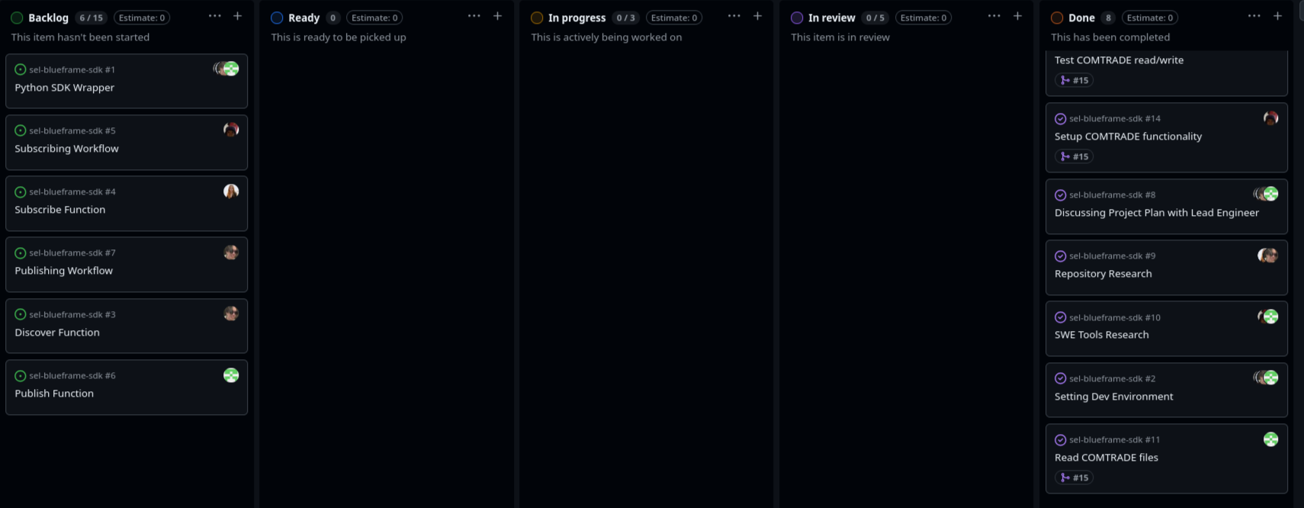
KANBAN BOARD OVERVIEW AND TEAM CONTRIBUTIONS

Slide 15
WEBSITE DEVELOPMENT
Our project is a backend API and does not involve a website
As a result, we do not have static or dynamic elements to present

Slide 16
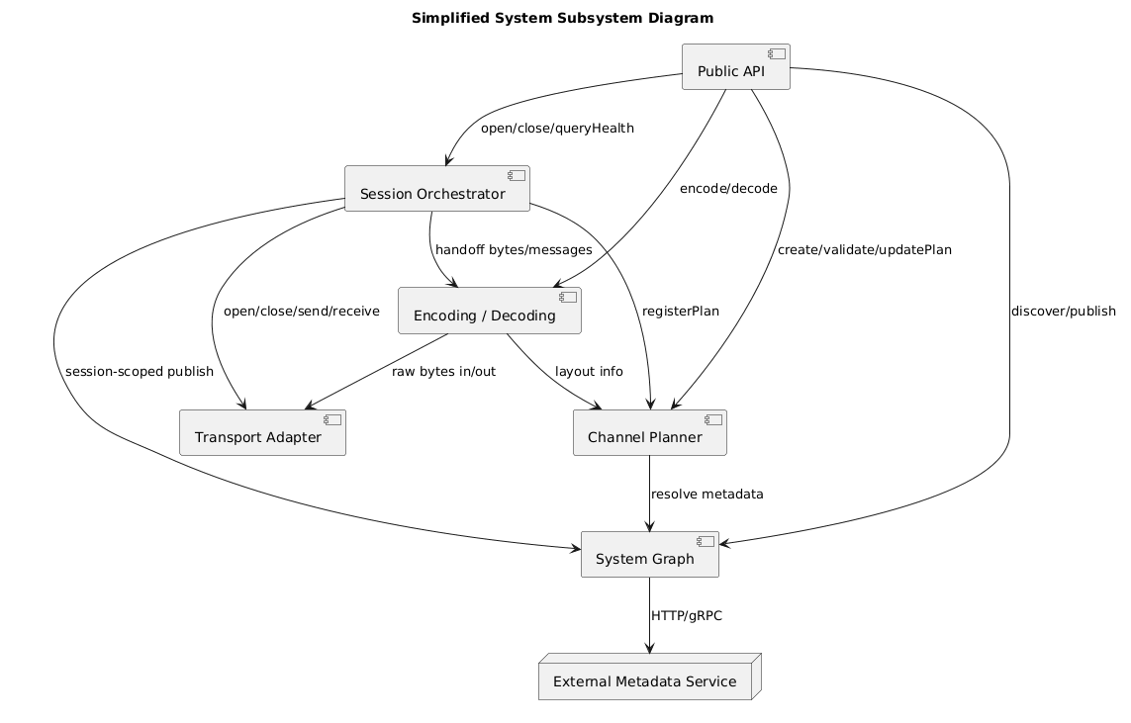
PROPSED SYSTEM ARCHITECTURE DESIGN

Slide 17
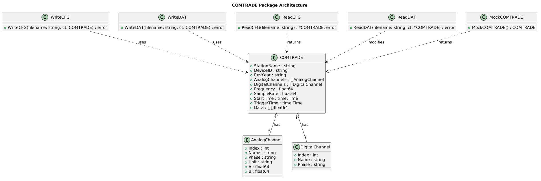
GO COMTRADE ARCHITECTURE

Slide 18
DATABASE DESIGN
Our project is a backend SDK for an embedded operating system, and thus does not have a database component.

Slide 19
UI DESIGN
Our project is a backend SDK for an embedded operating system, and thus does not have any graphical user interface. The extent of the user interface is written documentation for the code, which fully maps to our client’s expectations and requirements.

Slide 20
TESTING PLAN
Unit Testing Implemented unit tests for each function in the COMTRADE reader and writer as part of our testing harness written in Go. Tested edge cases such as malformed formatting, corrupted data, and crash handling to ensure reliability in embedded scenarios.
Integration Testing We combined the reader, writer, and validation modules into a unified workflow Tested end-to-end functionality on simulated workflows to validate the components’ interactivity
System Testing We integrated our Go modules with existing SEL signaling devices to test whether these devices could correctly produce and interpret COMTRADE data in a realistic environment
Tools & Methods Used JUnit, Selenium, and Jest for structured and automated testing Applied standard testing practices including edge case validation, regression checks, and manual verification
Key Issue & Resolution We identified an issue with floating point rounding errors when handling very precise timestamps, leading to invalid sample timing. We were able to resolve this by switching to integer-based microsecond timestamps instead of floats

Slide 21
SPRINT ACHIEVEMENTS AND CHALLENGES
Achievements:
We delivered a solid proof of concept Go COMTRADE encoder and decoder while working with a language and tools completely new to us.
We maintained clear and consistent communication during a challenging situation involving multiple stakeholders in order to coordinate the resolution of blockers
We showed strong adaptability and teamwork, especially when working through tight timelines and unexpected delays
Challenges:
We were unable to access critical files, which completely blocked development and pushed much of our work behind schedule. We addressed this by pivoting our project towards a smaller, relatively independent sub-component that will be useful later.
Progress From Sprint 1:
Sprint 1 was focused around planning architecture and developing contacts that we could use within SEL and for our project
Sprint 2 built on this work by making use of our contacts and following up on the research we did in Sprint 1, discovering that a lot of our initial assumptions about resource availability were wrong.

Slide 22
NEXT STEPS AND SPRINT RETROSPECTIVE
This sprint had some significant blockers related to security clearances and resource access. Without access to the existing Go repo or the Blueframe SDK, no code, tests, or prototypes could be created, which limited our ability to complete planned work.
Amidst these blockers, we received feedback from the client suggesting we pivot to public facing projects to continue research and proof of concept development. We acted on this feedback by redirecting our efforts and were able to successfully deliver a proof of concept for a Go Python wrapper.
Overall, while access challenges impacted progress, we strengthened our communication channels within SEL and improved our ability to navigate internal processes, which will help reduce friction in future sprints.
Our next sprint will focus on building on this proof of concept and developing it into a full prototype, including support for additional file types, compression, and error correction, while continuing to pursue access to required internal resources.

Slide 23
RESPONSIBLE USE OF AI
We used AI for summarizing/understanding meetings, drafting some documents, and identifying potential use cases to propose to our stakeholders
Limitations:
Since our project contains SEL specific information, AI is often not able to answer questions about the specific technologies and implementations. Thus , we sought out other documentation to answer more specific technical questions.
We used the SEL specific GitHub Copilot to process SEL-confidential information to ensure security of SEL information. This is necessary because typical non-company AI tools do not fit within security regulations for SEL.

Slide 24
CONCLUSION
This sprint was impacted by delays in obtaining key resources, including the Blueframe SDK and internal repositories, which limited our ability to fully execute planned work.
Despite these challenges, we made meaningful progress by deepening our understanding of the Blueframe system and developing valuable proof of concept tools, progressing both on the field SDK and the go COMTRADE proof of concept.
We appreciate the continued support from our client, mentors, and faculty, along with SEL employees outside of our team who offered help.
Looking ahead, we are in a good place to move quickly as soon as access we receive access to our critical resources. With a stronger technical foundation and improved alignment, we are confident in our ability to deliver impactful results in the upcoming sprints.

Slide 25
THANK YOU

